Slide 1
www.wvac2024.com
‘Resilience in the face of adversity’

Slide 2
4 Days
11,200m² Convention Centre
3 Floor Levels
20 Parallel Breakaway Rooms
250+ Presentations
6 Congress-within-Congress
6,600m² Exhibition Hall
Hundred and Eighty 9m² booths 1,500 pax Catering Hall
Official Welcome Reception
Exclusive African Gala Dinner
3rd Largest Airport in Africa
22 Direct International Flights
20,000 hotel rooms
4,000 in walking distance

Slide 3
Host Country: South Africa
The only country in the world to have hosted the Soccer, Cricket and Rugby World Cup
The only country to have two Nobel Peace Prize Winners living on the same street
Accessible
Affordable
Natural Beauty
World Class Facilities
Adventure
Good Weather
Rainbow Nation
Diverse Experiences
Wildlife
Responsible Tourism
11 official languages

Slide 4
Home of the Big 5 &
7th Wonder of the World

Slide 5
Host City:
Cape Town

Slide 6
Experience cape town
Here are 5 reasons why you should attend WVAC 2024:
1. The Weather
To explore all this natural beauty, the climate in Cape Town is that of a year-round, mild Californian/Mediterranean one - gracing us with long summer days to explore all that the city has to offer. The annual average temperature in Cape Town is a delightful 17-25 degrees Celsius in April (that’s between 63- and 77-degrees Fahrenheit for all you international folks.)
2. The Adventure
Being home to iconic mountain ranges, stunning natural wonders, thrilling landscapes and ocean vistas, Cape Town offers no shortage of adventures. Known as the adventure capital of South Africa, the lifestyle of locals and visitors' alike centers around the outdoors and an active lifestyle. Find something for every member of the family like hiking, diving, cruising or climbing, to paragliding, abseiling, kloofing or shark-cage diving for the adrenaline junkies out there. With so much on offer, the city of Cape Town has endless attractions for people from all over the world, making it well worth a visit for the authentic Cape Town experience.
3. The Food
Cape Town is no doubt the undisputed culinary capital of South Africa. It is home to some of the country’s best and most inventive chefs and has proven itself by winning the Condé Nast’s Readers’ Choice Awards as the best food city in the world a couple of years ago. In Cape Town - you can explore wine routes, wine festivals, wine estates and wine tasting at some of the nation's most prestigious estates. And better yet, explore them with City Sightseeing and our various wine tours.
4. The Buzz
Upon arriving at WVAC2024 in Cape Town, one can feel the palpable electricity in the air as colleagues reunite, students reconnect with old classmates, and speakers are warmly greeted by the organizing staff. The vibrant buzz of connection, camaraderie, and community permeates the halls of the Cape Town International Convention Center, as attendees come together with a shared goal of self-improvement through learning.
5. The Value
With so much to do and see all in one city, you will find incredible value in Cape Town while you learn from the brightest minds in the industry, earn CE and most importantly, have fun! With attraction ticket discounts, 4,000 hotel rooms in walking distance, and a week filled with world-class learning, you will certainly get your money’s worth out of your trip to WVAC2024.
Sound exciting?

Slide 7
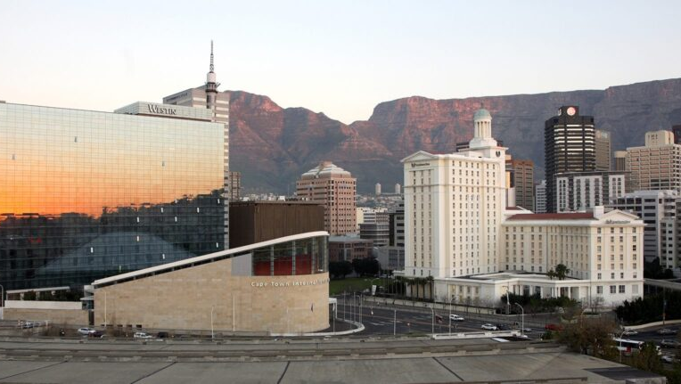
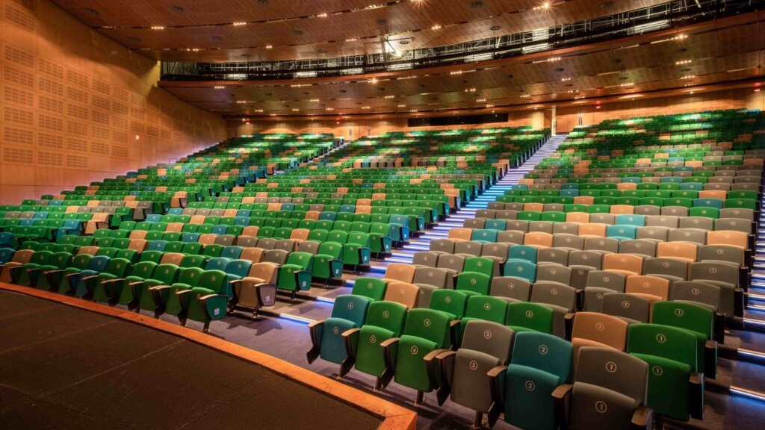
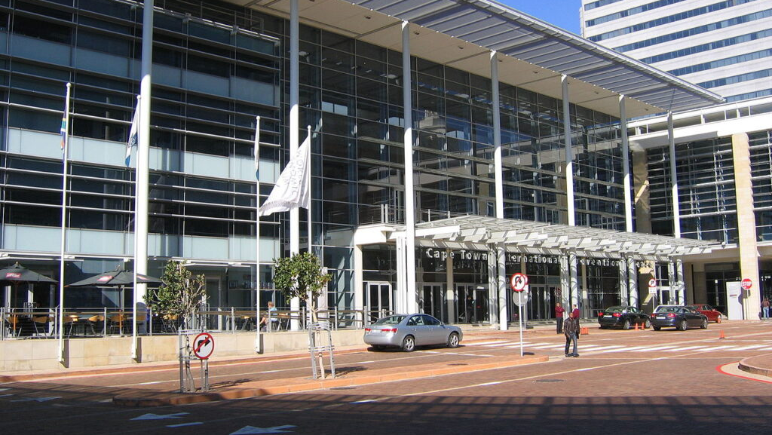
Host Venue:
Cape Town International
Convention Centre

Slide 8
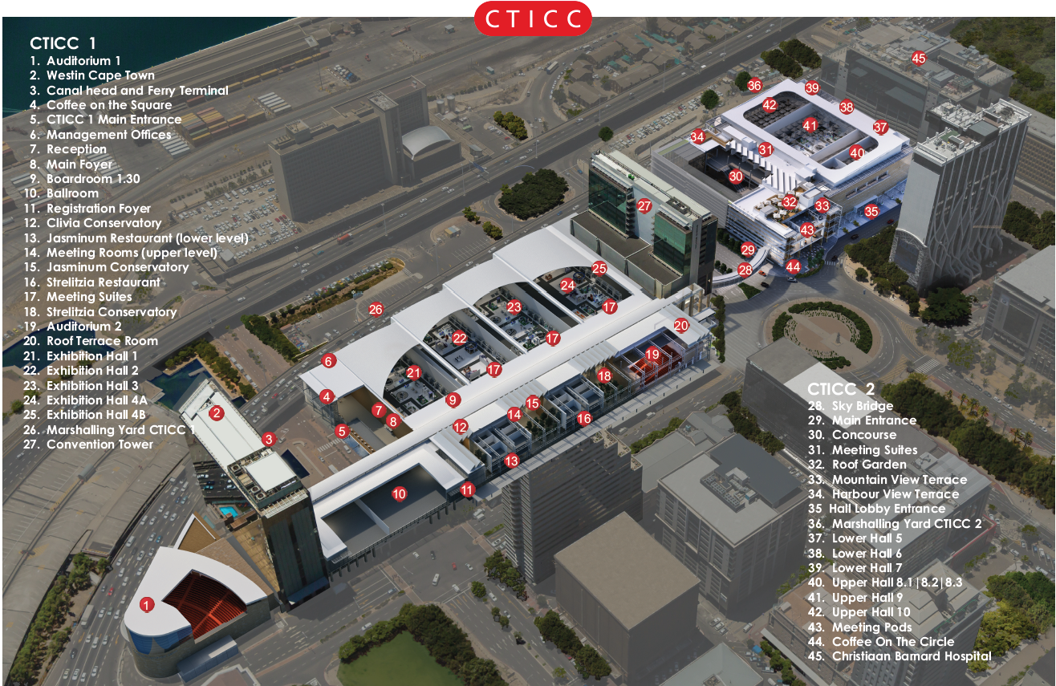
Venue Bird’s eye view

Slide 9
Accommodation
brucer@turnersconferences.co.za
https://wvac2024.com/accommodation/

Slide 10
Programme highlights
With 6 parallel Annual congresses and 230 + presentations happening simultaneously throughout the 4-day event, WVAC 2024 covers content for all areas of veterinary science. See a sample of programme tracks below and visit our website for the complete schedule.
Annual Congress 2024
Annual Congress
12th Biennial Congress 2024
Annual
Congress 2024
Annual Congress 2024
2024
Animal Ethics & Welfare
Business Practice/ Management
Epidemiology
Equine
One Health
Ruminants
Small Animals
Veterinary History
Veterinary Nursing
Wildlife & Exotics
Personal Development
Mental Wellness

Slide 11
2024 Proposed Programme
‘Resilience in the face of Adversity’
Monday, 15 April 2024 16:00 - All Delegates Registration Desk Open – badge pickup
Tuesday, 16 April 2024 07:00 - Registration Opens 08:30 - Opening Plenary 10:10 - Parallel Congress Sessions | WVA General Assembly (full day) 18:00 - Official Welcome Reception in Exhibition Hall (included in full attendance registration fees)
Wednesday, 17 April 2024 07:00 - Registration Opens 08:30 - Full Day Congress | WVA One Health Summit (full day) 18:00 - Free Evening | Industry Hosted Events
Thursday, 18 April 2024 07:00 - Registration Opens 08:30 - Full Day Congress 18:30 - Congress Gala Dinner @ GOLD (limited space available)
Friday, 19 April 2024 07:00 - Registration Opens 08:30 - Half-day Congress (ending around 15h00pm) 11:00 - Closing Plenary & Hand-over Ceremony 12:30 - Parallel Congress Sessions continue 16:00 - Close of Congress

Slide 12
39th World Veterinary Association Congress
www.wvac2024.com
We can’t wait to welcome you!

